Slide 1




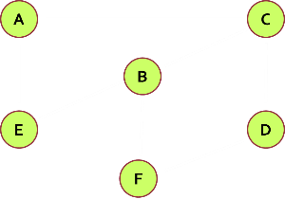
Graphs and Graph Algorithms
Fundamentals, Terminology, Traversal, Algorithms
Graph Algorithms
SoftUni Team
Technical Trainers
Software University
http://softuni.bg

Slide 2
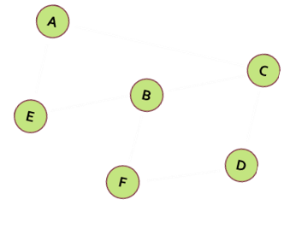
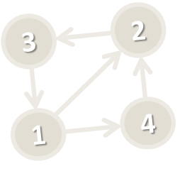

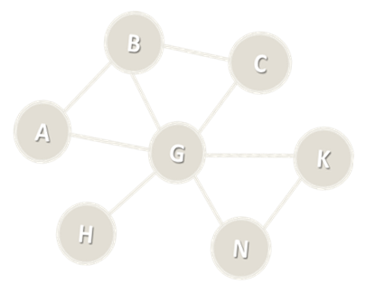
Table of Contents
Graph Definitions and Terminology
Representing Graphs
Graph Traversal Algorithms
Depth-First-Search (DFS)
Breadth-First-Search (BFS)
Connected Components
Topological Sorting
Source Removal and DFS Algorithms

Slide 3
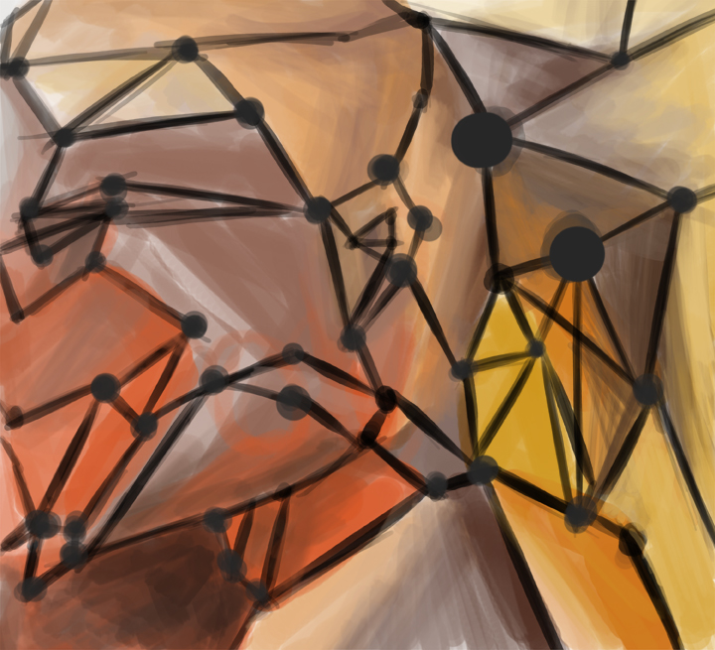
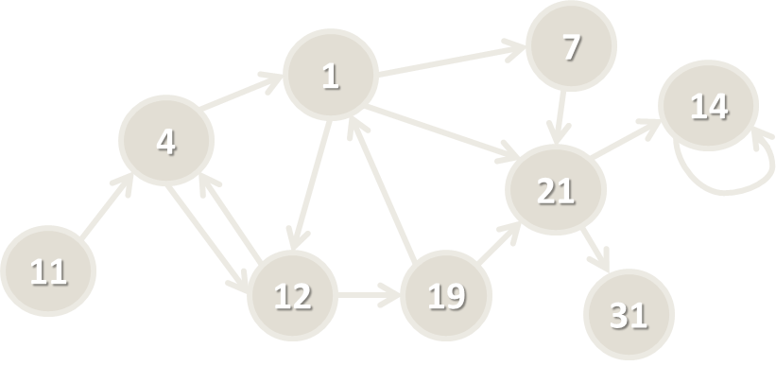
Graphs
Definitions and Terminology

Slide 4
Graph Data Structure
Graph, denoted as G(V, E)
Set of nodes V with many-to-many relationship between them (edges E)
Each node (vertex) has multiple predecessors and multiple successors
Edges connect two nodes (vertices)
Node with multiple successors
Node with multiple predecessors
Edge
7
1
14
4
21
11
Self-relationship (loop)
Node
12
19
31

Slide 5
Graph Definitions
Node (vertex)
Element of a graph
Can have name / value
Keeps a list of adjacent nodes
Edge
Connection between two nodes
Can be directed / undirected
Can be weighted / unweighted
Can have name / value
Node
A
Edge
A
B

Slide 6
Graph Definitions (2)
Directed graph
Edges have direction
Undirected graph
Undirected edges
22
2
3
A
F
7
J
1
4
D
G
21
12
E
C
H
19
3

Slide 7
Graph Definitions (3)
Weighted graph
Weight (cost) is associated with each edge
10
A
F
4
5
N
J
6
16
8
Q
D
7
22
G
9
3
14
K
E
C
H

Slide 8
Graph Definitions (4)
Path (in undirected graph)
Sequence of nodes n₁, n₂, … n_{k}
Edge exists between each pair of nodes n_{i}, n_{i+1}
Examples:
A, B, C is a path
A, B, G, N, K is a path
H, K, C is not a path
H, G, G, B, N is not a path
B
C
A
G
K
H
N

Slide 9
Graph Definitions (5)
Path (in directed graph)
Sequence of nodes n₁, n₂, … n_{k}
Directed edge exists between each pair of nodes n_{i}, n_{i+1}
Examples:
A, B, C is a path
N, G, A, B, C is a path
A, G, K is not a path
H, G, K, N is not a path
B
C
A
G
K
H
N

Slide 10
Graph Definitions (6)
Cycle
Path that ends back at the starting node
Example of cycle: A, B, C, G, A
Simple path
No cycles in path
Acyclic graph
Graph with no cycles
Acyclic undirected graphs are trees
B
C
A
G
K
H
N

Slide 11
Graph Definitions (7)
Two nodes are reachable if а path exists between them
Connected graph
Every two nodes are reachable from each other
Unconnected graph holding two connected components
Connected graph
A
F
J
A
F
D
G
J
D
G
E
H
C

Slide 12
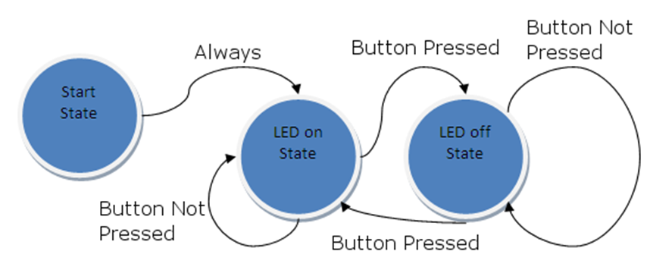


Graphs and Their Applications
Graphs have many real-world applications
Modeling a computer network like the Internet
Routes are simple paths in the network
Modeling a city map
Streets are edges, crossings are vertices
Social networks
People are nodes and their connections are edges
State machines
States are nodes, transitions are edges

Slide 13
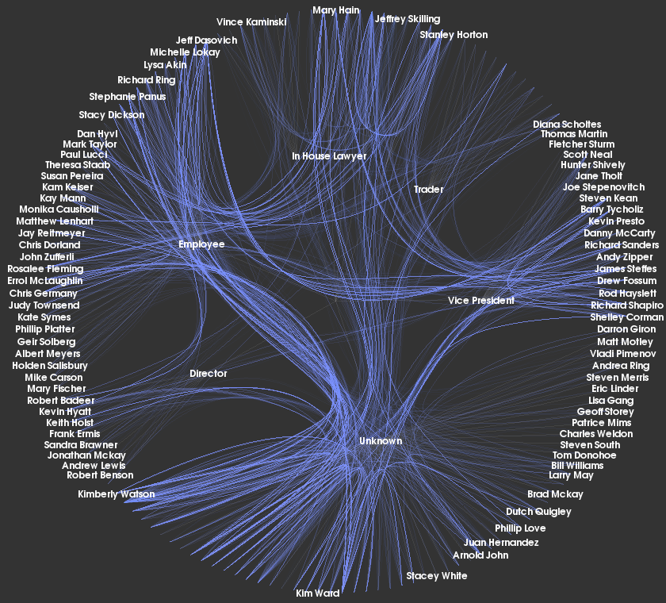
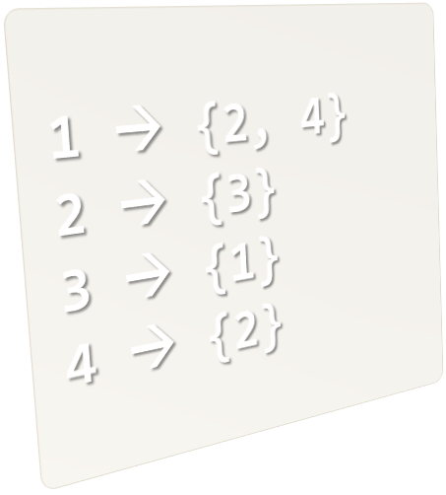
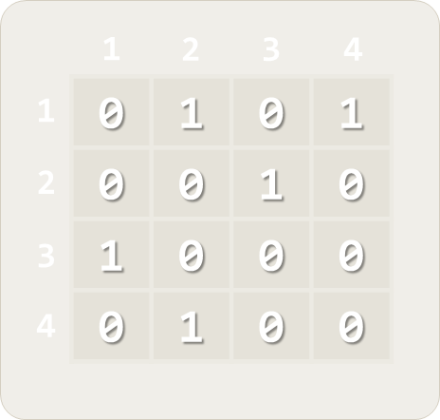
Representing Graphs
{1,2} {1,4} {2,3} {3,1} {4,2}
Classic and OOP Ways

Slide 14
Representing Graphs
Adjacency list
Each node holds a list of its neighbors
Adjacency matrix
Each cell keeps whether and how two nodes are connected
List of edges
1 → {2, 4}
2 → {3}
3 → {1}
4 → {2}
3
2
1
4
1
2
3
4
1
0 | 1 | 0 | 1
0 | 0 | 1 | 0
1 | 0 | 0 | 0
0 | 1 | 0 | 0
2
{1,2} {1,4} {2,3} {3,1} {4,2}
3
4

Slide 15
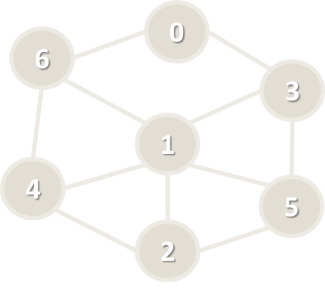
Graph Representation: Adjacency List
var g = new List<int>[] {
new List<int> {3, 6},
new List<int> {2, 3, 4, 5, 6},
new List<int> {1, 4, 5},
new List<int> {0, 1, 5},
new List<int> {1, 2, 6},
new List<int> {1, 2, 3},
new List<int> {0, 1, 4}
};
// Add an edge { 3 → 6 }
g[3].Add(6);
// List the children of node #1
var childNodes = g[1];

Slide 16
Graph Representation: Adjacency Matrix
var graph = new[,]
{ // 0 1 2 3 4 5 6
{ 0, 0, 0, 1, 0, 0, 1 }, // node 0
{ 0, 0, 1, 1, 1, 1, 1 }, // node 1
{ 0, 1, 0, 0, 1, 1, 0 }, // node 2
{ 1, 1, 0, 0, 0, 1, 0 }, // node 3
{ 0, 1, 1, 0, 0, 0, 1 }, // node 4
{ 0, 1, 1, 1, 0, 0, 0 }, // node 5
{ 1, 1, 0, 0, 1, 0, 0 }, // node 6
};
// Add an edge { 3 → 6 }
g[3, 6] = 1;
// List the children of node #1
var childNodes = g[1];

Slide 17
Graph Representation: List of Edges
class Edge
{
public int Parent {get; set; }
public int Child {get; set; } }
var graph = new List<Edge>() {
new Edge() { Parent = 0, Child = 3 },
new Edge() { Parent = 0, Child = 6 },
…
}
// Add an edge { 3 → 6 }
graph.Add(new Edge() { Parent = 3, Child = 6 });
// List the children of node #1
var childNodes = graph.Where(e => e.Parent == 1);

Slide 18
Numbering Graph Nodes
A common technique to speed up working with graphs
Numbering the nodes and accessing them by index (not by name)
Ruse
0
Plovdiv
6
3
Varna
1
Sofia
4
Bourgas
5
Stara Zagora
2
Pleven
Graph of numbered nodes: [0…6]
Graph of named nodes

Slide 19
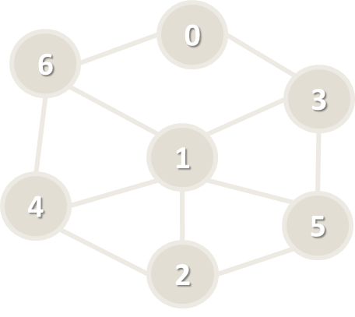
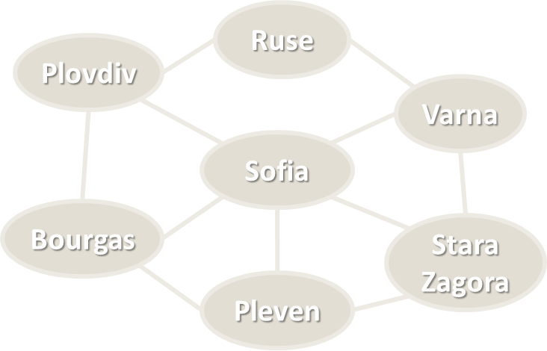
Numbering Graph Nodes – How?
Suppose we have a graph of n nodes
We can assign a number for each node in the range [0…n-1]
# | Node
0 | Ruse
1 | Sofia
2 | Pleven
3 | Varna
4 | Bourgas
5 | Stara Zagora
6 | Plovdiv
var g =
new List<int>[n]
var g = new Dictionary<
string, List<string>>

Slide 20

Graph of Named Nodes – Example
var graph = new Dictionary<string, List<string>>() {
{ "Sofia", new List<string>() {
"Plovdiv", "Varna", "Bourgas", "Pleven", "Stara Zagora" } },
{ "Plovdiv", new List<string>() {
"Bourgas", "Ruse" } },
{ "Varna", new List<string>() {
"Ruse", "Stara Zagora" } },
{ "Bourgas", new List<string>() {
"Plovdiv", "Pleven" } },
{ "Ruse", new List<string>() {
"Varna", "Plovdiv" } },
{ "Pleven", new List<string>() {
"Bourgas", "Stara Zagora" } },
{ "Stara Zagora", new List<string>() {
"Varna", "Pleven" } },
};

Slide 21
Graph of Numbered Nodes – Example
public class Graph
{
List<int>[] childNodes;
string[] nodeNames;
}
Graph g = new Graph(new List<int>[] {
new List<int> {3, 6}, // children of node 0 (Ruse)
new List<int> {2, 3, 4, 5, 6}, // successors of node 1 (Sofia)
new List<int> {1, 4, 5}, // successors of node 2 (Pleven)
new List<int> {0, 1, 5}, // successors of node 3 (Varna)
new List<int> {1, 2, 6}, // successors of node 4 (Bourgas)
new List<int> {1, 2, 3}, // successors of node 5 (Stara Zagora)
new List<int> {0, 1, 4} // successors of node 6 (Plovdiv)
},
new string[] {"Ruse", "Sofia", "Pleven", "Varna", "Bourgas", … });

Slide 22
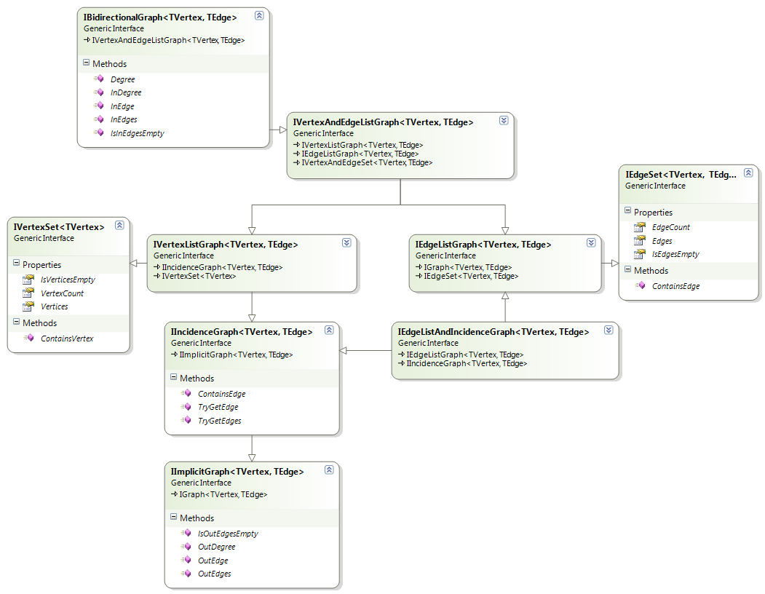
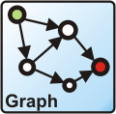
OOP-Based-Graph Representation
Using OOP:
Class Node
Class Edge (Connection)
Class Graph
Optional classes
Algorithm classes
Using external graph and algorithms library:
QuickGraph – http://quickgraph.codeplex.com

Slide 23
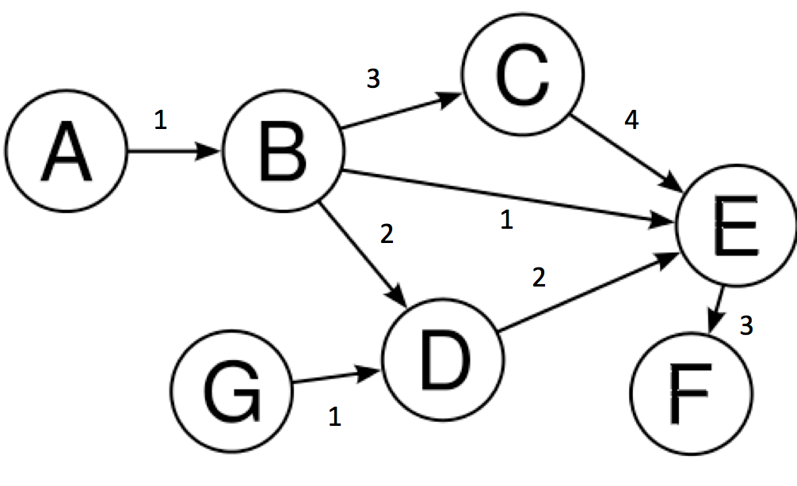
Representing Graphs
Live Demo

Slide 24
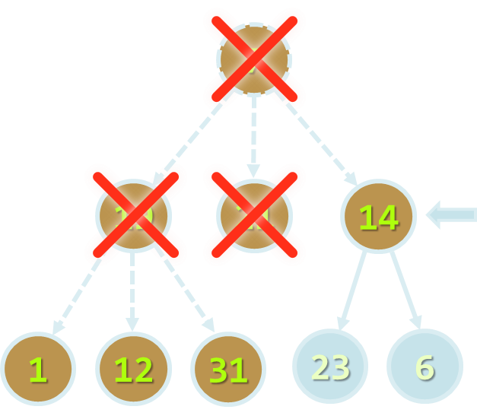
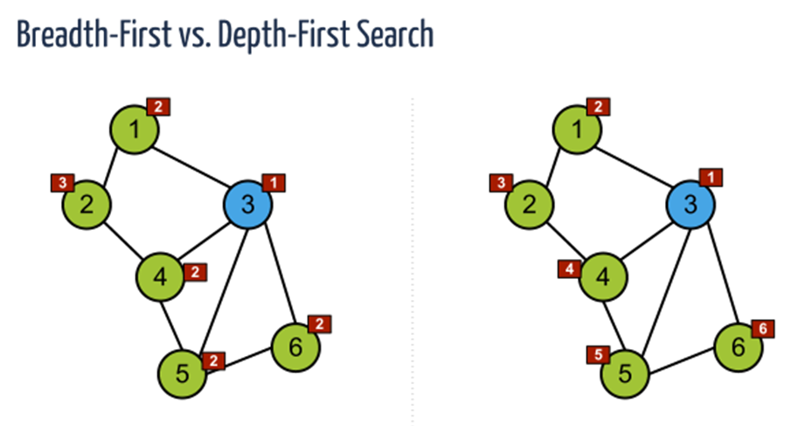
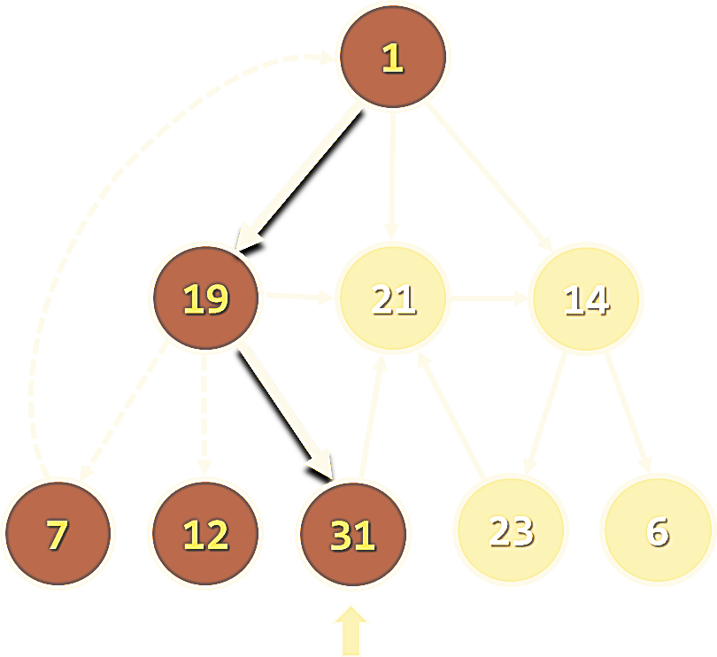
Graphs Traversals
Depth-First Search (DFS) and Breadth-First Search (BFS)

Slide 25

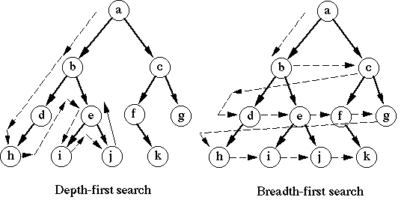
Graph Traversal Algorithms
Traversing a graph means to visit each of its nodes exactly once
The order of visiting nodes may vary on the traversal algorithm
Depth-First Search (DFS)
Visit node's successors first
Usually implemented by recursion
Breadth-First Search (BFS)
Nearest nodes visited first
Implemented with a queue

Slide 26
Depth-First Search (DFS)
Depth-First Search (DFS) first visits all descendants of given node recursively, finally visits the node itself
visited[0 … n-1] = false;
for (v = 0 … n-1) DFS(v)
DFS (node)
{
if not visited[node] {
visited[node] = true;
for each child c of node
DFS(c);
print node;
}
}
9
1
8
19
6
21
5
14
1
2
7
4
3
7
12
31
23
6

Slide 27
DFS in Action (Step 1)
Stack: 1
Output: (empty)
Start DFS from the initial node 1
1
19
21
14
7
12
31
23
6

Slide 28
DFS in Action (Step 2)
Stack: 1, 19
Output: (empty)
Enter recursively into the first child 19
1
19
21
14
7
12
31
23
6

Slide 29
DFS in Action (Step 3)
Stack: 1, 19, 7
Output: (empty)
Enter recursively into the first child 7
1
19
21
14
7
12
31
23
6

Slide 30
DFS in Action (Step 4)
Stack: 1, 19, 7, 1
Output: (empty)
Enter recursively into the first child 1
1
19
21
14
7
12
31
23
6

Slide 31
DFS in Action (Step 5)
Stack: 1, 19, 7
Output: (empty)
Node 1 already visited → return back
1
19
21
14
7
12
31
23
6

Slide 32
DFS in Action (Step 6)
Stack: 1, 19
Output: 7
Return back from recursion and print the last visited node
1
Print node 7
19
21
14
7
12
31
23
6

Slide 33
DFS in Action (Step 7)
Stack: 1, 19, 12
Output: 7
Enter recursively into the next child 12
1
19
21
14
7
12
31
23
6

Slide 34
DFS in Action (Step 8)
Stack: 1, 19
Output: 7, 12
Return back from recursion and print the last visited node
1
Print node 12
19
21
14
7
12
31
23
6

Slide 35
DFS in Action (Step 9)
Stack: 1, 19, 31
Output: 7, 12
Enter recursively into the next child 31
1
19
21
14
7
12
31
23
6

Slide 36
DFS in Action (Step 10)
Stack: 1, 19, 31, 21
Output: 7, 12
Enter recursively into the first child 21
1
19
21
14
7
12
31
23
6

Slide 37
DFS in Action (Step 11)
Stack: 1, 19, 31, 21, 14
Output: 7, 12
Enter recursively into the first child 14
1
19
21
14
7
12
31
23
6

Slide 38
DFS in Action (Step 12)
Stack: 1, 19, 31, 21, 14, 6
Output: 7, 12
Enter recursively into the first child 6
1
19
21
14
7
12
31
23
6

Slide 39
DFS in Action (Step 13)
Stack: 1, 19, 31, 21, 14
Output: 7, 12, 6
Return back from recursion and print the last visited node
1
Print node 6
19
21
14
7
12
31
23
6

Slide 40
DFS in Action (Step 14)
Stack: 1, 19, 31, 21, 14, 23
Output: 7, 12, 6
Enter recursively into the next child 23
1
19
21
14
7
12
31
23
6

Slide 41
DFS in Action (Step 15)
Stack: 1, 19, 31, 21, 14, 23, 21
Output: 7, 12, 6
Enter recursively into the first child 21
1
19
21
14
7
12
31
23
6

Slide 42
DFS in Action (Step 16)
Stack: 1, 19, 31, 21, 14, 23
Output: 7, 12, 6
Node 21 already visited → return back
1
19
21
14
7
12
31
23
6

Slide 43
DFS in Action (Step 17)
Stack: 1, 19, 31, 21, 14
Output: 7, 12, 6, 23
Return back from recursion and print the last visited node
1
Print node 23
19
21
14
7
12
31
23
6

Slide 44
DFS in Action (Step 18)
Stack: 1, 19, 31, 21
Output: 7, 12, 6, 23, 14
Return back from recursion and print the last visited node
1
Print node 14
19
21
14
7
12
31
23
6

Slide 45
DFS in Action (Step 19)
Stack: 1, 19, 31
Output: 7, 12, 6, 23, 14, 21
Return back from recursion and print the last visited node
1
Print node 21
19
21
14
7
12
31
23
6

Slide 46
DFS in Action (Step 20)
Stack: 1, 19
Output: 7, 12, 6, 23, 14, 21, 31
Return back from recursion and print the last visited node
1
Print node 31
19
21
14
7
12
31
23
6

Slide 47
DFS in Action (Step 21)
Stack: 1, 19, 21
Output: 7, 12, 6, 23, 14, 21, 31
Enter recursively into the next child 21
1
19
21
14
7
12
31
23
6

Slide 48
DFS in Action (Step 22)
Stack: 1, 19
Output: 7, 12, 6, 23, 14, 21, 31
Node 21 already visited → return back
1
19
21
14
7
12
31
23
6

Slide 49
DFS in Action (Step 23)
Stack: 1
Output: 7, 12, 6, 23, 14, 21, 31, 19
Return back from recursion and print the last visited node
1
Print node 19
19
21
14
7
12
31
23
6

Slide 50
DFS in Action (Step 24)
Stack: 1, 21
Output: 7, 12, 6, 23, 14, 21, 31, 19
Enter recursively into the next child 21
1
19
21
14
7
12
31
23
6

Slide 51
DFS in Action (Step 25)
Stack: 1
Output: 7, 12, 6, 23, 14, 21, 31, 19
Node 21 already visited → return back
1
19
21
14
7
12
31
23
6

Slide 52
DFS in Action (Step 26)
Stack: 1, 14
Output: 7, 12, 6, 23, 14, 21, 31, 19
Enter recursively into the next child 14
1
19
21
14
7
12
31
23
6

Slide 53
DFS in Action (Step 27)
Stack: 1
Output: 7, 12, 6, 23, 14, 21, 31, 19
Node 14 already visited → return back
1
19
21
14
7
12
31
23
6

Slide 54
DFS in Action (Step 28)
Stack: (empty)
Output: 7, 12, 6, 23, 14, 21, 31, 19, 1
Return back from recursion and print the last visited node
1
Print node 1
19
21
14
DFS traversal completed
7
12
31
23
6

Slide 55
Recursive DFS Graph Traversal
6
6
7
7
Ruse
0
6
5
Plovdiv
5
3
2
Varna
2
1
1
Sofia
1
4
4
4
Bourgas
Stara Zagora
3
5
3
2
Pleven
Live Demo

Slide 56
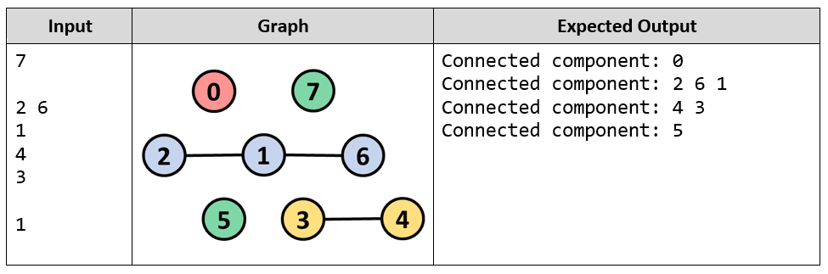
DFS for Graph Traversals
Live Coding (Lab)

Slide 57
Breadth-First Search (BFS)
Breadth-First Search (BFS) first visits the neighbor nodes, then the neighbors of neighbors, then their neighbors, etc.
BFS (node)
{
queue ← node
visited[node] = true
while queue not empty
v ← queue
print v
for each child c of v
if not visited[c]
queue ← c
visited[c] = true
}
1
7
2
19
3
21
4
14
5
6
7
8
9
1
12
31
23
6

Slide 58
BFS in Action (Step 1)
Queue: 7
Output:
Initially enqueue the root node 7
7
19
21
14
1
12
31
23
6

Slide 59
BFS in Action (Step 2)
Queue: 7
Output: 7
Remove from the queue the next node and print it
7
Print node 7
19
21
14
1
12
31
23
6

Slide 60
BFS in Action (Step 3)
Queue: 7, 19
Output: 7
Enqueue all children of the current node
7
Enqueue the first child 19
19
21
14
1
12
31
23
6

Slide 61
BFS in Action (Step 4)
Queue: 7, 19, 21
Output: 7
Enqueue all children of the current node
7
Enqueue the second child 21
19
21
14
1
12
31
23
6

Slide 62
BFS in Action (Step 5)
Queue: 7, 19, 21, 14
Output: 7
Enqueue all children of the current node
7
Enqueue the third child 14
19
21
14
1
12
31
23
6

Slide 63
BFS in Action (Step 6)
Queue: 7, 19, 21, 14
Output: 7, 19
Remove from the queue the next node and print it
7
Print node 19
19
21
14
1
12
31
23
6

Slide 64
BFS in Action (Step 7)
Queue: 7, 19, 21, 14, 1
Output: 7, 19
Enqueue all children of the current node
7
Enqueue the first child 1
19
21
14
1
12
31
23
6

Slide 65
BFS in Action (Step 8)
Queue: 7, 19, 21, 14, 1, 12
Output: 7, 19
Enqueue all children of the current node
7
Enqueue the second child 12
19
21
14
1
12
31
23
6

Slide 66
BFS in Action (Step 9)
Queue: 7, 19, 21, 14, 1, 12, 31
Output: 7, 19
Enqueue all children of the current node
7
Enqueue the third child 31
19
21
14
1
12
31
23
6

Slide 67
BFS in Action (Step 10)
Queue: 7, 19, 21, 14, 1, 12, 31
Output: 7, 19
Child node 21 already visited → skip it
7
19
21
14
1
12
31
23
6

Slide 68
BFS in Action (Step 11)
Queue: 7, 19, 21, 14, 1, 12, 31
Output: 7, 19, 21
Remove from the queue the next node and print it
7
Print node 21
19
21
14
1
12
31
23
6

Slide 69
BFS in Action (Step 12)
Queue: 7, 19, 21, 14, 1, 12, 31
Output: 7, 19, 21
Child node 14 already visited → skip it
7
19
21
14
1
12
31
23
6

Slide 70
BFS in Action (Step 13)
Queue: 7, 19, 21, 14, 1, 12, 31
Output: 7, 19, 21, 14
Remove from the queue the next node and print it
7
Print node 14
19
21
14
1
12
31
23
6

Slide 71
BFS in Action (Step 14)
Queue: 7, 19, 21, 14, 1, 12, 31, 23
Output: 7, 19, 21, 14
Enqueue all children of the current node
7
Enqueue the first child 23
19
21
14
1
12
31
23
6

Slide 72
BFS in Action (Step 15)
Queue: 7, 19, 21, 14, 1, 12, 31, 23, 6
Output: 7, 19, 21, 14
Enqueue all children of the current node
7
Enqueue the second child 6
19
21
14
1
12
31
23
6

Slide 73
BFS in Action (Step 16)
Queue: 7, 19, 21, 14, 1, 12, 31, 23, 6
Output: 7, 19, 21, 14, 1
Remove from the queue the next node and print it
7
Print node 1
19
21
14
1
12
31
23
6

Slide 74
BFS in Action (Step 17)
Queue: 7, 19, 21, 14, 1, 12, 31, 23, 6
Output: 7, 19, 21, 14, 1
Child node 7 already visited → skip it
7
19
21
14
1
12
31
23
6

Slide 75
BFS in Action (Step 18)
Queue: 7, 19, 21, 14, 1, 12, 31, 23, 6
Output: 7, 19, 21, 14, 1, 12
Remove from the queue the next node and print it
7
Print node 12
19
21
14
No child nodes to enqueue
1
12
31
23
6

Slide 76
BFS in Action (Step 19)
Queue: 7, 19, 21, 14, 1, 12, 31, 23, 6
Output: 7, 19, 21, 14, 1, 12, 31
Remove from the queue the next node and print it
7
Print node 31
19
21
14
1
12
31
23
6

Slide 77
BFS in Action (Step 20)
Queue: 7, 19, 21, 14, 1, 12, 31, 23, 6
Output: 7, 19, 21, 14, 1, 12, 31
Child node 21 already visited → skip it
7
19
21
14
1
12
31
23
6

Slide 78
BFS in Action (Step 21)
Queue: 7, 19, 21, 14, 1, 12, 31, 23, 6
Output: 7, 19, 21, 14, 1, 12, 31, 23
Remove from the queue the next node and print it
7
Print node 23
19
21
14
1
12
31
23
6

Slide 79
BFS in Action (Step 22)
Queue: 7, 19, 21, 14, 1, 12, 31, 23, 6
Output: 7, 19, 21, 14, 1, 12, 31, 23
Child node 21 already visited → skip it
7
19
21
14
1
12
31
23
6

Slide 80
BFS in Action (Step 23)
Queue: 7, 19, 21, 14, 1, 12, 31, 23, 6
Output: 7, 19, 21, 14, 1, 12, 31, 23, 6
Remove from the queue the next node and print it
7
Print node 6
19
21
14
No child nodes to enqueue
1
12
31
23
6

Slide 81
BFS in Action (Step 24)
Queue: 7, 19, 21, 14, 1, 12, 31, 23, 6
Output: 7, 19, 21, 14, 1, 12, 31, 23, 6
The queue is empty → stop
7
BFS traversal completed
19
21
14
1
12
31
23
6

Slide 82
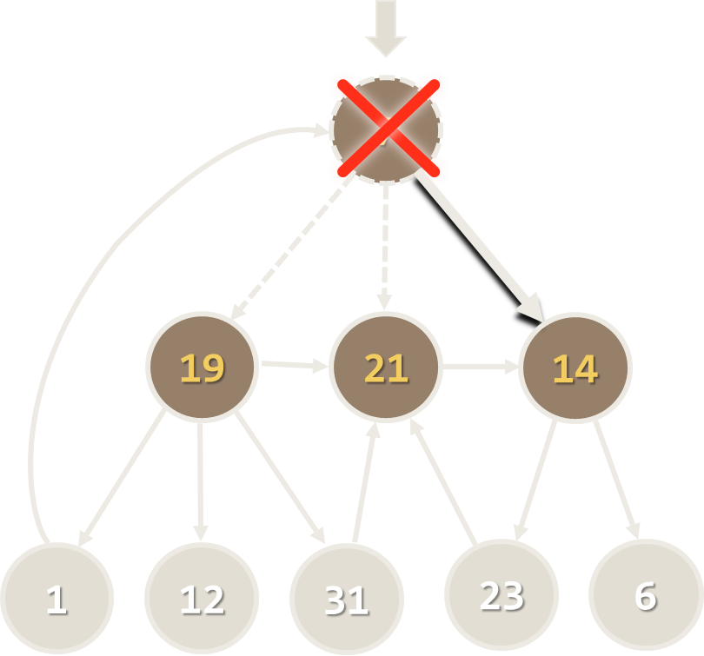
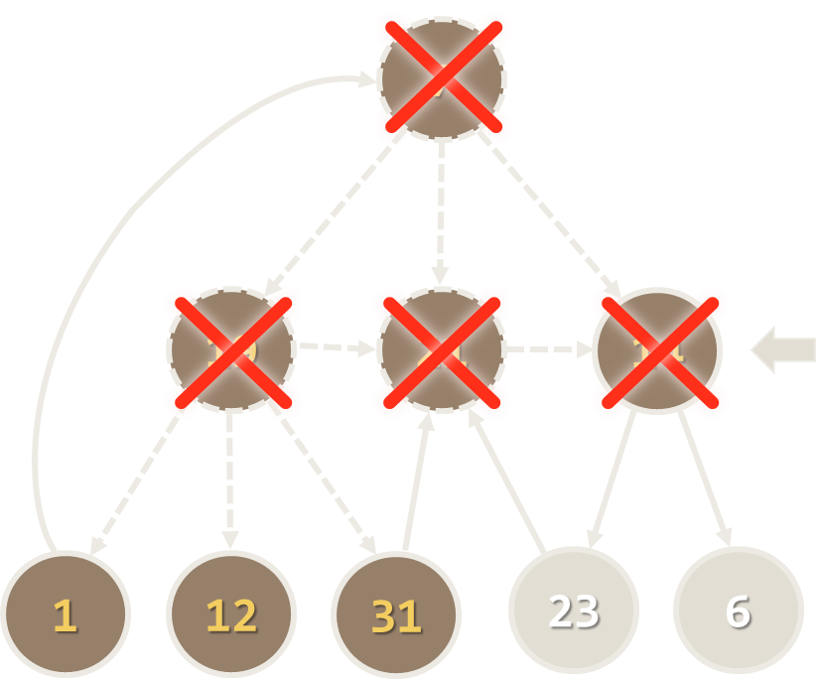
BFS Graph Traversal
3
2
Ruse
Plovdiv
3
2
Varna
1
Sofia
3
Bourgas
Stara Zagora
2
Pleven
Live Demo

Slide 83
Iterative DFS and BFS
What will happen if in the Breadth-First Search (BFS) algorithm we change the queue with a stack?
An iterative stack-based Depth-First Search (DFS)
BFS (node)
{
queue ← node
visited[node] = true
while queue not empty
v ← queue
print v
for each child c of v
if not visited[c]
queue ← c
visited[c] = true
}
DFS (node)
{
stack ← node
visited[node] = true
while stack not empty
v ← stack
print v
for each child c of v
if not visited[c]
stack ← c
visited[c] = true
}

Slide 84
Iterative DFS Graph Traversal
6
6
7
7
Ruse
0
6
5
Plovdiv
5
3
2
Varna
2
1
1
Sofia
1
4
4
4
Bourgas
Stara Zagora
3
5
3
2
Pleven
Live Demo

Slide 85
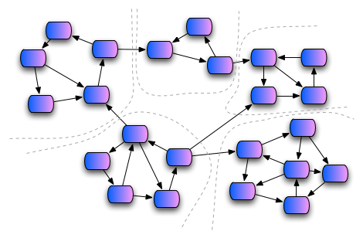
Graph Connectivity
Finding the Connected Components

Slide 86

Graph Connectivity
Connected component of undirected graph
A sub-graph in which any two nodes are connected to each other by paths
E.g. the graph on the right consists of 3 connected components

Slide 87
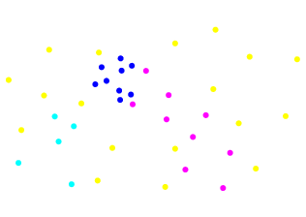
Finding All Graph Connected Components
Finding the connected components in a graph
Loop through all nodes and start a DFS / BFS traversing from any unvisited node
Each time you start a new traversal
You find a new connected component

Slide 88
Graph Connected Components: Algorithm
visited[] = false;
foreach node from graph G
{
if (not visited[node])
{
DFS(node);
countOfComponents++;
}
}
DFS (node)
{
if (not visited[node])
{
visited[node] = true;
foreach c in node.children
DFS(c);
}
}
A
F
C
O
K
N
L
Q
E
D
G
H
M
I
B
P
J

Slide 89
Finding the Connected Components in an Undirected Graph
J
M
O
I
C
F
Q
E
A
K
N
H
G
L
D
P
B
Live Demo

Slide 90
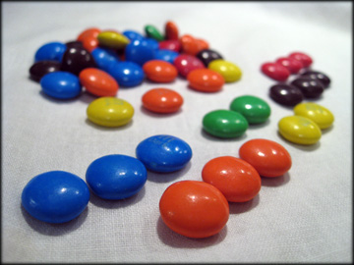
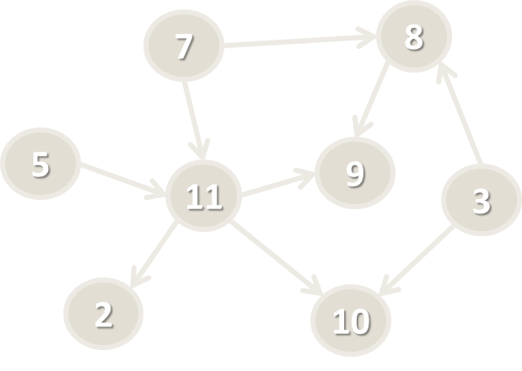
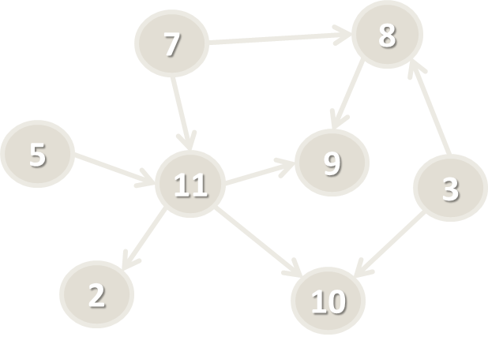
Topological Sorting
Ordering a Graph by Set of Dependencies

Slide 91
Topological Sorting
Topological sorting (ordering) of a directed graph
Linear ordering of its vertices, such that
For every directed edge from vertex u to vertex v, u comes before v in the ordering
Example:
7 → 5 → 3 → 11 → 8 → 2 → 9 → 10
3 → 5 → 7 → 8 → 11 → 2 → 9 → 10
5 → 7 → 3 → 8 → 11 → 10 → 9 → 2
7
8
5
9
11
3
2
10

Slide 92
Topological Sorting – Example
We have a set of learning topics with dependencies
Order the topics in such order that all dependencies are met
Example:
Loops depend on variables, conditionals and IDEs
Variables depend on IDEs
Bits depend on variables and loops
Conditionals depend on variables
Ordering:
IDEs → variables → loops → bits
IDEs
conditionals
variables
loops
bits

Slide 93
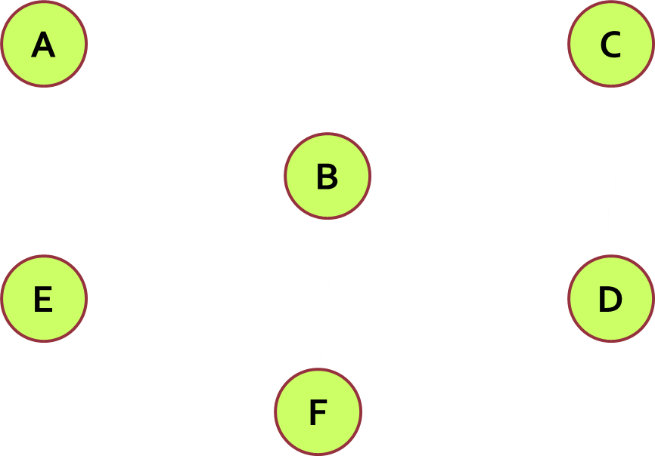
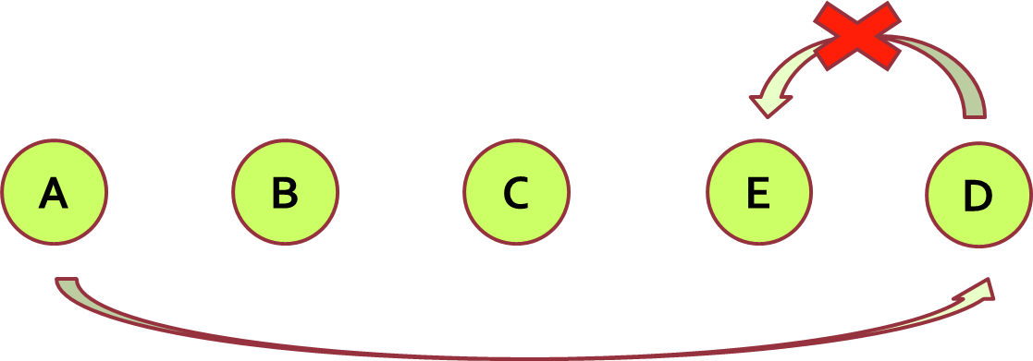
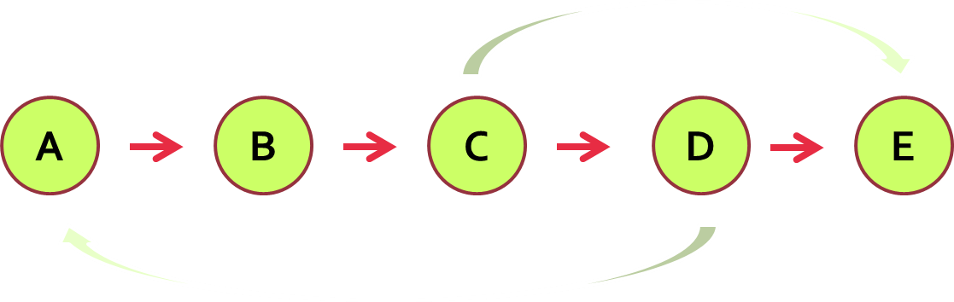
Topological Sorting – Rules
Rules
Undirected graphs cannot be sorted
Graphs with cycles cannot be sorted
Sorting is not unique
Various sorting algorithms exists and they give different results

Slide 94
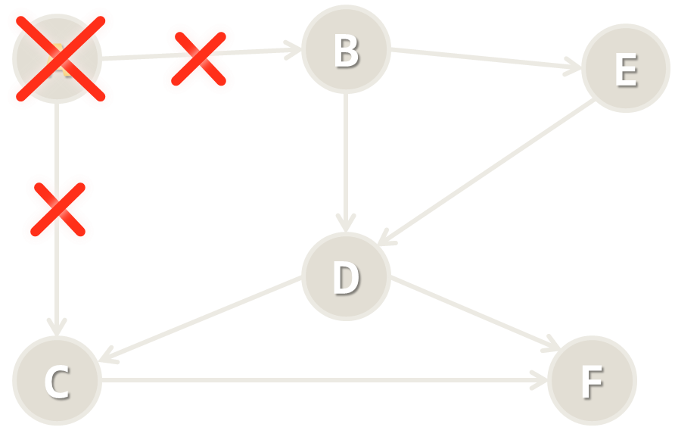
Topological Sorting: Source Removal Algorithm
Source removal top-sort algorithm:
Create an empty list
Repeat until the graph is empty:
Find a node without incoming edges
Print this node
Remove the edge from the graph

Slide 95
Source Removal Algorithm
L ← empty list that will hold the sorted elements (output)
S ← set of all nodes with no incoming edges
while S is non-empty do
remove some node n from S
append n to L
for each node m with an edge e: { n → m }
remove edge e from the graph
if m has no other incoming edges then
insert m into S
if graph is empty
return L (a topologically sorted order)
else
return "Error: graph has at least one cycle"

Slide 96
Step #1: Find a Node with No Incoming Edges
A
B
E
The node A is the only node without incoming edges
D
C
F
L

Slide 97
Step #2: Remove Node A with Its Edges
A
B
E
D
C
F
L
A

Slide 98
Step #3: Find a Node with No Incoming Edges
B
E
The node B is the only node without incoming edges
D
C
F
L
A

Slide 99
Step #4: Remove Node B with Its Edges
B
E
D
C
F
L
A
B

Slide 100
Step #5: Find a Node with No Incoming Edges
The node E is the only node without incoming edges
E
D
C
F
L
A
B

Slide 101
Step #6: Remove Node E with Its Edges
E
D
C
F
L
A
B
E

Slide 102
Step #7: Find a Node with No Incoming Edges
The node D is the only node without incoming edges
D
C
F
L
A
B
E

Slide 103
Step #8: Remove Node D with Its Edges
D
C
F
L
A
B
E
D

Slide 104
Step #9: Find a Node with No Incoming Edges
The node C is the only node without incoming edges
C
F
L
A
B
E
D

Slide 105
Step #10: Remove Node C with Its Edges
C
F
L
A
B
E
D
C

Slide 106
Step #11: Find a Node with No Incoming Edges
The node F is the only node without incoming edges
F
L
A
B
E
D
C

Slide 107
Step #12: Remove Node F with Its Edges
F
L
A
B
E
D
C
F

Slide 108
Result: Topological Sorting
A
B
E
D
C
F

Slide 109
Topological Sorting: Source Removal Algorithm
0
4
3
5
1
2
Live Demo

Slide 110
Topological Sorting: DFS Algorithm
sortedNodes = { } // linked list to hold the result
visitedNodes = { } // set of already visited nodes
foreach node in graphNodes
TopSortDFS(node)
TopSortDFS(node)
if node ∉ visitedNodes
visitedNodes ← node
for each child c of node
TopSortDFS(c)
insert node upfront in the sortedNodes
Visualization: https://www.cs.usfca.edu/~galles/visualization/TopoSortDFS.html

Slide 111
TopSort: DFS Algorithm + Cycle Detection
sortedNodes = { } // linked list to hold the result
visitedNodes = { } // set of already visited nodes
cycleNodes = { } // set of nodes in the current DFS cycle
foreach node in graphNodes
TopSortDFS(node)
TopSortDFS(node)
if node ϵ cycleNodes
return "Error: cycle detected"
if node ∉ visitedNodes
visitedNodes ← node
cycleNodes ← node
for each child c of node
TopSortDFS(c)
remove node from cycleNodes
insert node upfront in the sortedNodes

Slide 112
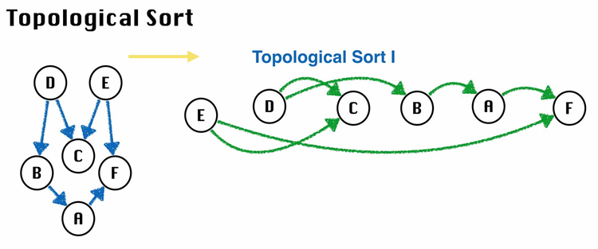
Topological Sorting
Live Coding (Lab)

Slide 113

Summary
Representing graphs in memory
Adjacency list holding the children for each node
Adjacency matrix
List of edges
Numbering the nodes for faster access
Depth-First Search (DFS) – recursive in-depth traversal
Breadth-First Search (BFS) – in-width traversal with a queue
Topological sorting – source removal algorithms and DFS algorithm

Slide 114









Graphs and Graph Algorithms
https://softuni.bg/trainings/1331/algorithms-april-2016

Slide 115
License
This course (slides, examples, labs, videos, homework, etc.) is licensed under the "Creative Commons Attribution-NonCommercial-ShareAlike 4.0 International" license
Attribution: this work may contain portions from
"Fundamentals of Computer Programming with C#" book by Svetlin Nakov & Co. under CC-BY-SA license
"Data Structures and Algorithms" course by Telerik Academy under CC-BY-NC-SA license

Slide 116






Free Trainings @ Software University
Software University Foundation – softuni.org
Software University – High-Quality Education, Profession and Job for Software Developers
softuni.bg
Software University @ Facebook
facebook.com/SoftwareUniversity
Software University @ YouTube
youtube.com/SoftwareUniversity
Software University Forums – forum.softuni.bg

